Slide 1
Final Presentation Sentiment Analysis Project
Cornellius Yudha Wijaya

Slide 2
Introduction
Natural Language Processing (NLP) is a field that deal with computer to teach the meaning behind the word. One of the process in the NLP field is Sentiment analysis
Sentiment analysis is a process to understand emotional meaning behind the written word
Sentiment analysis is useful to gain overview understanding of the online opinion quickly at the certain platform, such as social media and online shopping

Slide 3
Problem
Sentiment analysis is not a perfect science. Machine, without contextual understanding unable to understand the intent behind the word
To teach the contextual understanding to the machine, it require reliable dataset and machine learning model
The process to understand the meaning behind each word manually would involve significant time and effort

Slide 4
Target
Acquire a model that capable to predict the sentiment behind the written word and ready to be used in the business industry
Amazon review dataset provided by the opendata AWS resources is a reliable dataset to be processed for sentiment analysis purpose
With reliable dataset, theoretically it would be possible to achieved a great model for sentiment prediction

Slide 5
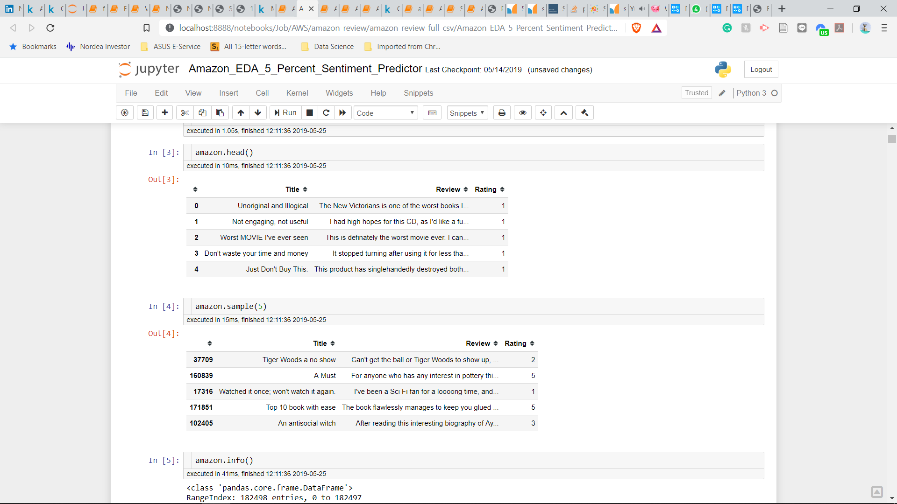
Data
Initially, the data was split into 3 features. Title, Review and Rating
For Sentiment analysis process, Rating 1 and 2 are considered as ‘Negative’ Sentiment, Rating 3 is considered as ‘Neutral’ Sentiment, and Rating 4 and 5 are considered as ‘Positive’ Sentiment

Slide 6
EDA
Refer to the Notebook and Dashboard

Slide 7
Model
Refer to the Notebook and Dashboard

Slide 8
Shortcoming
The model have a good accuracy, but the precision and recall for the ‘Neutral’ sentiment need to be better
The model depend on the sentence length. The review prediction model would certainly need longer word compared to the title prediction model. This problem is sort of alleviated by combining both the title and the review sentence together, but in real life business it would be only useful in the data that contain both of this feature. Otherwise, it would be better to use either the title or review prediction model depend on the sentence length.

Slide 9
Conclusion
The model already acquired a good accuracy, but still need improvement; specifically to predicting the ‘Neutral’ Sentiment

Slide 10
Recommendation
Further EDA to pinpoint the word that useful for predicting each sentiment
Apply further analysis text processing such as lemmatization and tagging
Increase the number of the data used for model processing

Slide 11
Thank You

